Slide 1
User Research Summary
Prepared by the Digital Service at Veterans Affairs (DSVA)
Prepared for and presented to the VA Web Brand Consolidation Working Group
July 19, 2018

Slide 2
Outline
We gathered feedback from hundreds of Veterans about our plans for a new va.gov experience.
Study 1 – “Others” Resources Card Sort
Study 2 – Benefit Lifecycle Card Sort
Study 3a – Homepage Wireframes v1
Study 3b – Homepage Wireframes v2
Study 4a – Navigation Tree Test v1
Study 4b – Navigation Tree Test v2

Slide 3
Study 4a – Navigation Tree Test v1

Slide 4
Our goal was to validate the navigation model for VA.gov
Study 4a – Navigation Tree Test v1
Created a tree test in Optimal Workshop
User given 10 out of 30 possible tasks
Tries to navigate through the menu to find the answer
Distributed to 10k Veterans via MyHealtheVet mailing list
Received 715 responses (June 18-20)
97% Veterans, limited family members and caregivers

Slide 5
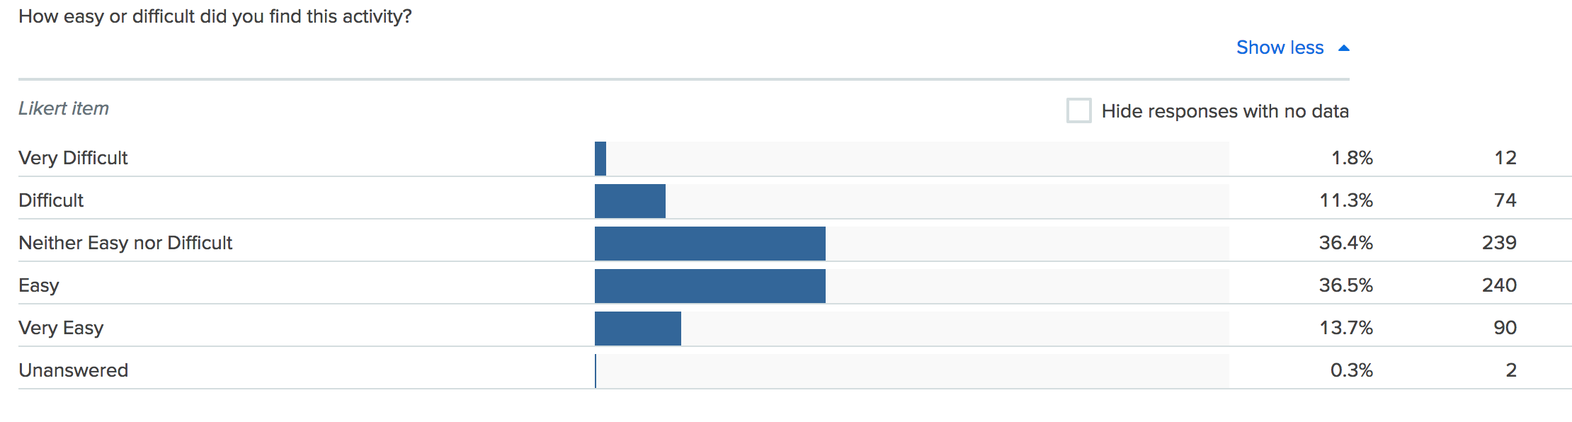
Veterans generally found the study easy to complete
Study 4a – Navigation Tree Test v1

Slide 6
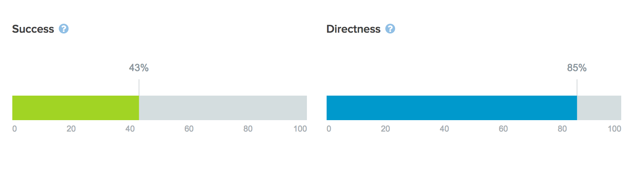
Overall, the results were not great
Study 4a – Navigation Tree Test v1

Slide 7
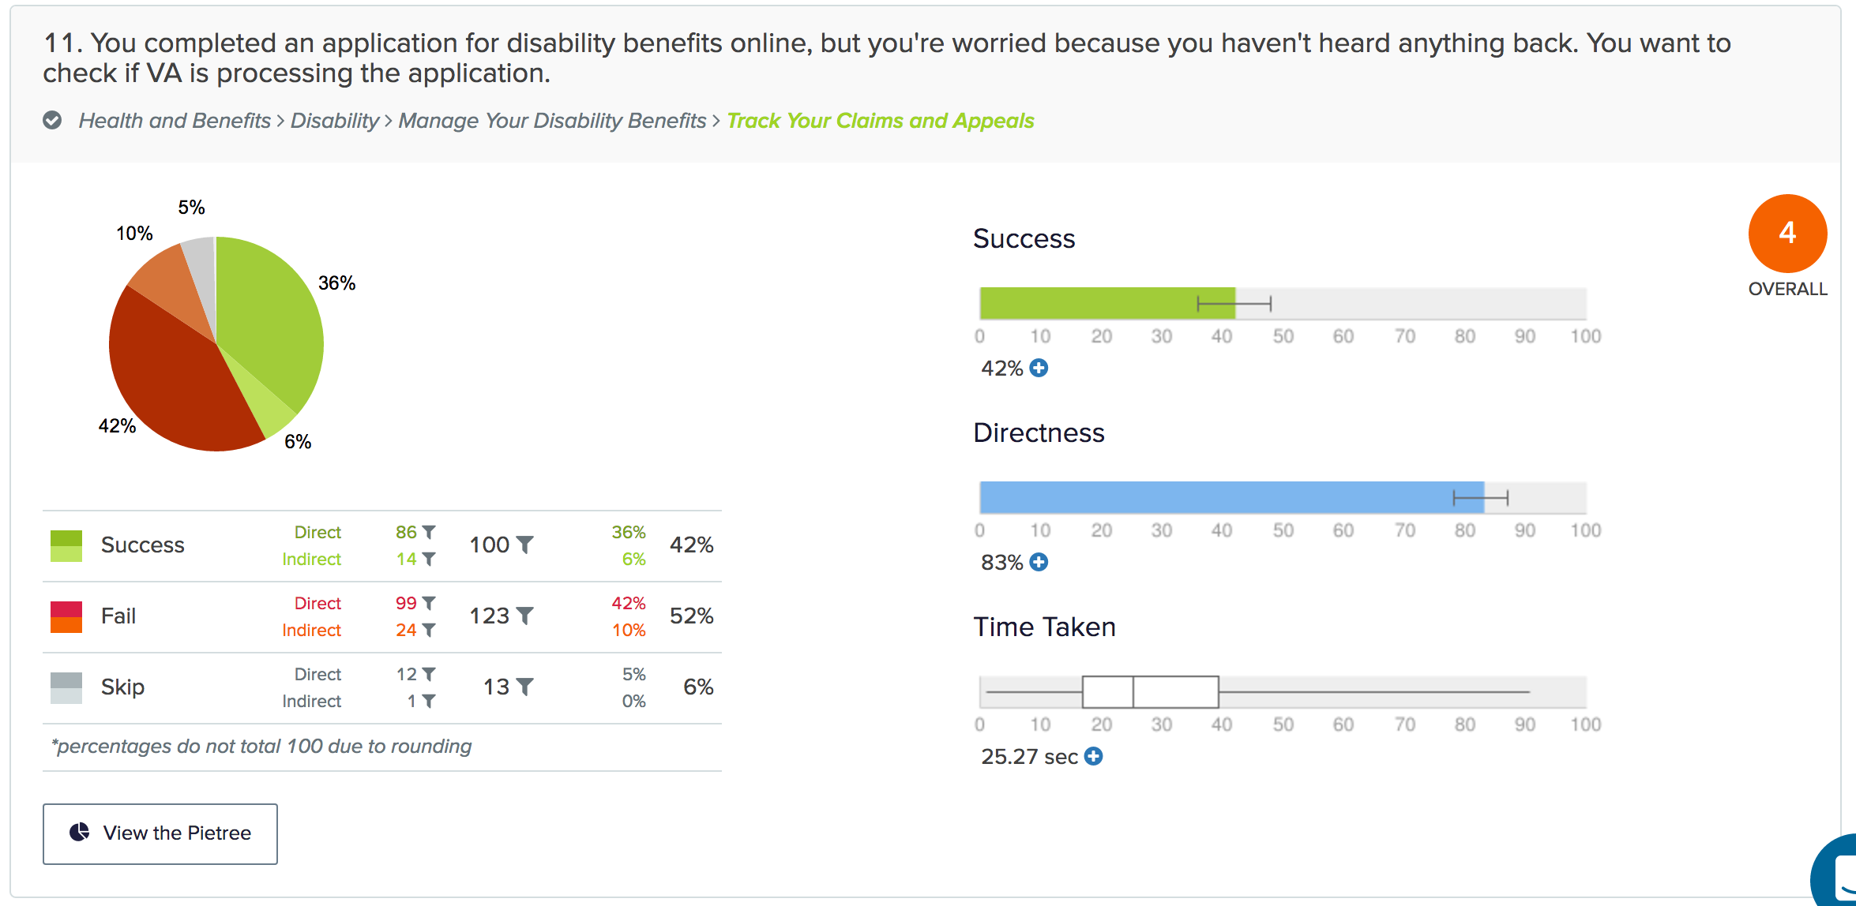

Slide 8
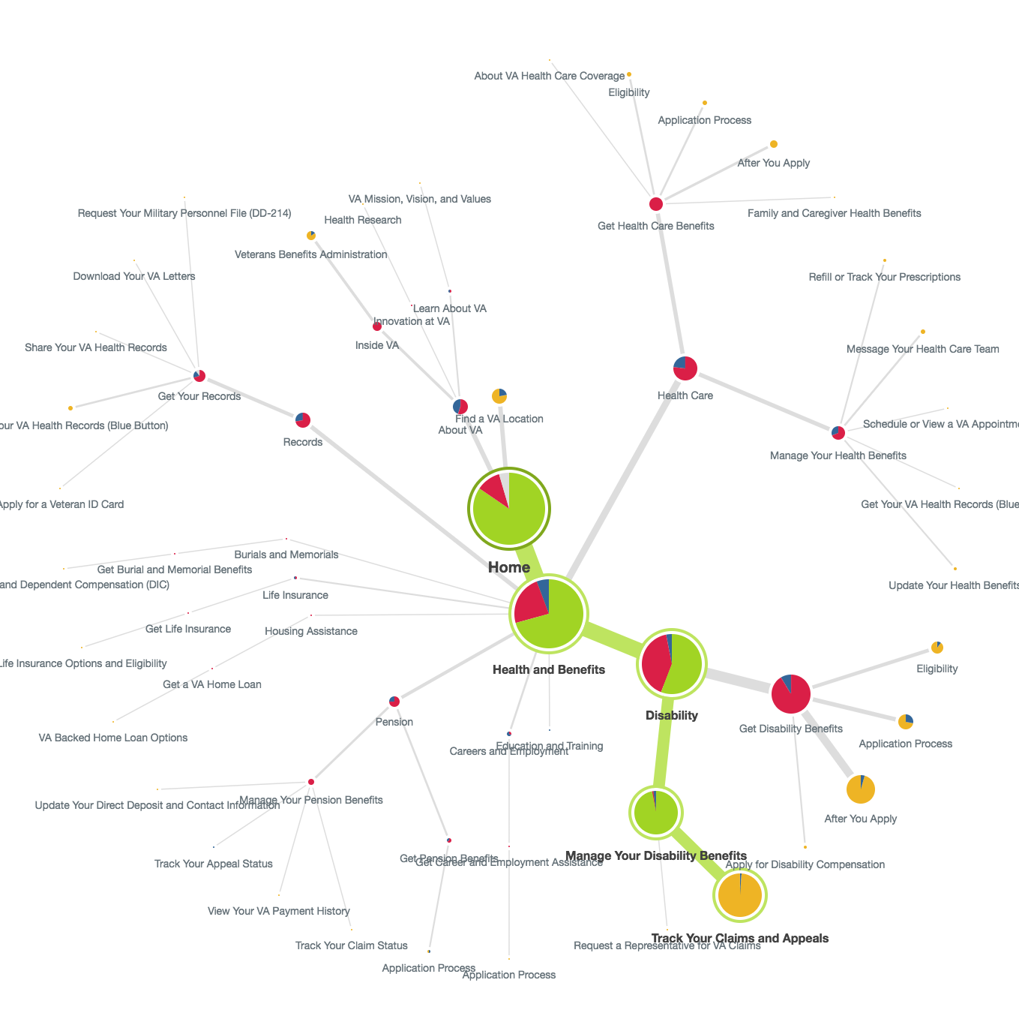

Slide 12
Veterans struggled to navigate the menu to complete top tasks
Study 4a – Navigation Tree Test v1
Scores ranged from 2 - 6 (we want 7 and above)
Directness scores indicate that users were confident in their incorrect answers
The sheer volume of content and number of levels in the menu contributed to the overall poor performance
Choosing between “Get” and “Manage” benefits continued to distract users

Slide 13
Top tasks
Study 4a – Navigation Tree Test v1
Health Care tasks – Both “About VA” and “Find a VA Location” were common incorrect paths
For health conditions information – “About VA” was a common path
Health tasks mostly scored 4s, ranged 3-5.
Disability tasks – Users were looking in the Health hub for “Apply” tasks and in the Records hub for “track and manage” tasks
Upload Docs and Add/Remove Dependent scored 2s. Others 4-5.
Education tasks – Users frequently chose incorrect “apply” links. Scores ranged 4-5.

Slide 14
More tasks
Study 4a – Navigation Tree Test v1
Records tasks – “About VA” was a common incorrect path. Scores 3-6.
Pension tasks – Disability hub was the most common incorrect path. Scored all 4s.
Jobs task – “About VA” was the first misstep for most users but many were also confused by “Get” vs “Manage”. Score 2.
Cemetery tasks – Scored 6s, generally good with some distraction by “About VA” and “Pre-Need”.
Facility Locator – Scored 9. Listed at the top level of nav.
About VA tasks – Scored 2s. Largely done as an info gathering activity, needs more research.

Slide 15
We need to update our navigation and apply the lessons learned
Study 4a – Navigation Tree Test v1
Simplify the mega menu options by reducing the number of links per section
Consolidate the “Apply” entry points in the menu for each benefit
Cross-link between the Health, Disability, Pension, and Records hubs for alternative navigation paths
Cross-link from the Facility Locator and Facility pages to the Health hub
Re-organize the Jobs menu options
Discuss “About” Menu top tasks

Slide 16
What Now?
Study 4a – Navigation Tree Test v1
More research!
We learned a lot from this first study and need to make some big improvements to the menu options. Next, we will run the same tasks against the new design and watch for improvements.

Slide 17
Study 4b – Navigation Tree Test v2

Slide 18
Our goal was to determine if a simplified mega menu is a reasonable solution to va.gov
Study 4b – Navigation Tree Test v2
Created a tree test in Optimal Workshop
User given 9 out of 28 possible tasks
Tries to navigate through the menu to find the answer
Distributed to 8k Veterans via MyHealtheVet mailing list
Received 596 responses (June 18-20)
96% Veterans, 3% Spouses, limited other family members and caregivers

Slide 19
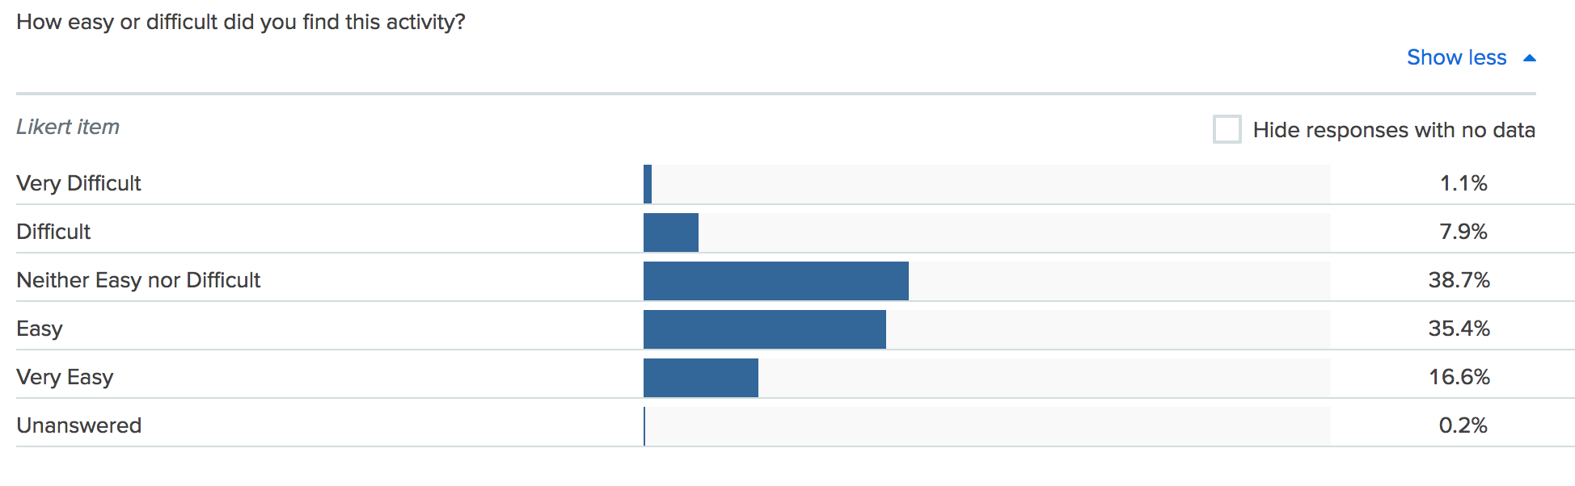
Veterans found the study easy to complete
Study 4b – Navigation Tree Test v2

Slide 20
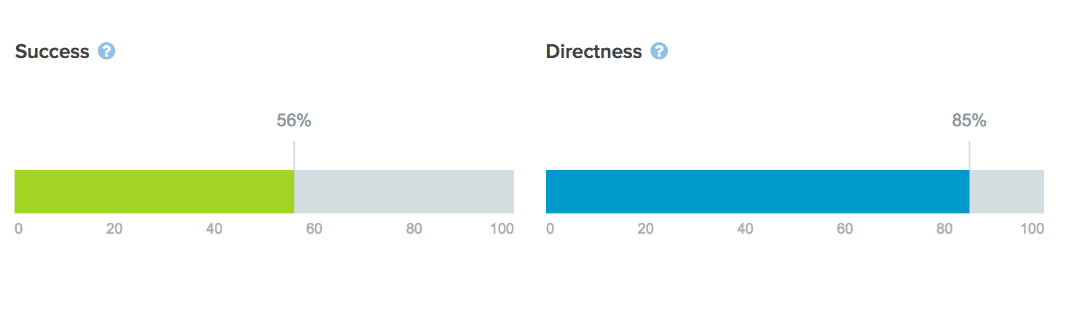
Overall, the results improved with the simplified design
Study 4b – Navigation Tree Test v2

Slide 21
Health & Disability
Study 4b – Navigation Tree Test v2
Health tasks generally performed well
About VA was a contributing distraction for health tasks (~10%)
Many Veterans looked in Records for disability management tasks (upload docs, direct deposit, add dependents)
Health Care and Pension were also commonly visited during disability tasks

Slide 22
Education, Records, Home Loan
Study 4b – Navigation Tree Test v2
About VA was the only consistent distractor on Education tasks (~28%)
About VA was the biggest distractor for Veteran ID (31%) and DD-214 (44%)
Disability was commonly visited when looking for VA Letters (38%)
About VA distracted from Home Loan COE (36%)

Slide 23
Pension and Jobs
Study 4b – Navigation Tree Test v2
About VA was a large distractor from Pension tasks
The other links in the Pension Hub distracted Veterans more than other hubs (81% success rate)
Most Veterans looked for Find a Job under About VA (62%)

Slide 24
Burials & About VA
Study 4b – Navigation Tree Test v2
Veterans looked under About VA for Find a Cemetery (44%)
Health Care was the most common destination for Veterans Choice Program
The other About VA categories (Learn, Innovation) were distractors from finding the Public Affairs content

Slide 25
Health Care Tasks
Study 4b – Navigation Tree Test v2
Task | Success | Primary Incorrect Paths
Apply | 69% | About VA (12%) / HC→About VA HC
Refill Prescription | 88% | None
Secure Messaging | 74% | About VA (10%) / Records
Online Scheduling | 76% | About VA (11%) / Records
Labs and Tests | 63% | Records → Blue Button (24%)
Hearing Aids | 77% | About VA (3%) / Disability
About | 72% | About VA (9%) / Disability / Education and Training

Slide 26
Disability Tasks
Study 4b – Navigation Tree Test v2
Task | Success | Primary Incorrect Paths
Apply | 61% | Health, Pension, Records (24%) / Eligibility (11%)
Eligibility | 50% | Health Care (19%) / About VA (11%)
Track Claims | 63% | About VA (21%) / Health, Records (17%)
Upload Docs | 51% | Records (16%) / Health, Pension (18%) / About VA (12%)
Add or Remove Dependent | 38% | Family and Caregivers (21%) / Records (11%) / Pension (11%)
Update Direct Deposit | 48% | About VA (38%) / Records (17%)

Slide 27
Education Tasks
Study 4b – Navigation Tree Test v2
Task | Success | Primary Incorrect Paths
Apply | 67% | About VA (23%)
Check GI Bill | 54% | About VA (32%)

Slide 28
Records & Home Loan
Study 4b – Navigation Tree Test v2
Task | Success | Primary Incorrect Paths
Veteran ID | 60% | About VA (31%) / Health Care (13%)
DD-214 | 60% | About VA (44%)
Blue Button | 70% | Health Care (26%)
VA Letters | 36% | Disability (38%) / About VA (16%)
Task | Success | Primary Incorrect Paths
Home Loan COE | 45% | About VA (36%) / HA→ How to Apply (10%)

Slide 29
Pension & Careers
Study 4b – Navigation Tree Test v2
Task | Success | Primary Incorrect Paths
Apply | 55% | About VA (19%) / Other Pension (13%)
Track Claim | 57% | About VA (18%) / Other Pension (12%)
Payment History | 52% | About VA (17%) / Records, Disability (16%)
Task | Success | Primary Incorrect Paths
Find a Job | 31% | About VA (62%)

Slide 30
Burials & About VA
Study 4b – Navigation Tree Test v2
Task | Success | Primary Incorrect Paths
Burial Allowances | 73% | About VA (12%) / Other Burial links (10%)
Find a Cemetery | 42% | About VA (44%) / Other Burial links (11%)
Task | Success | Primary Incorrect Paths
Veterans Choice | 8% | Health Care (80%)
Public Affairs | 29% | Learn About VA (41%) / Innovation at VA (16%)

Slide 31
We learned that the mega menu navigation model can work for VA
Study 4b – Navigation Tree Test v2
We may want to consider a term other than “About VA” to help distinguish benefits content from other VA content
We still have to rely heavily on cross-linking the hubs and redirecting users back from About VA pages to the benefits content
Each Hub will need additional research to refine the terms used

Slide 32
What Now?
Study 4b – Navigation Tree Test v2
Now that we’ve found a way to organize the massive content list for VA.gov, we must run individual studies to test the content in each Hub.

Slide 33
Thank you!
Contact Jeff Barnes with questions:
jeffrey.barnes4@va.gov

